Slide 1
William Stallings
Computer Organization and Architecture
7th Edition
Chapter 5
Memory

Slide 2
Syllabus
Characteristics of memory system and hierarchy, main memory ,ROM, Types of ROM, RAM, SRAM, DRAM, Flash memory, High speed memories
Cache Memory Organization: Address mapping, Replacement Algorithms, Cache Coherence, MESI protocol, Interleaved and associative memories, virtual memory, main memory allocation, segmentation paging, secondary storage ,RAID levels

Slide 3
Characteristics of Memory
Location
Capacity
Unit of transfer
Access method
Performance(SRAM,DRAM)
Physical type
Physical characteristics
Organisation
  Direct Mapping,Associative Mapping

Slide 4
Location
CPU
Internal
External

Slide 5
Capacity
Word size
  The natural unit of organisation
Number of words
  or Bytes

Slide 6
Unit of Transfer
Internal
  Usually governed by data bus width
External
  Usually a block which is much larger than a word
Addressable unit
  Smallest location which can be uniquely addressed

Slide 7

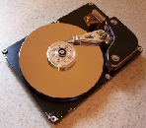
Access Methods (1)
Sequential
  Start at the beginning and read through in order
  Access time depends on location of data and previous location
  e.g. tape
Direct
  Individual blocks have unique address
  Access is by jumping to vicinity plus sequential search
  Access time depends on location and
  previous location
  e.g. disk

Slide 8
Access Methods (2)
Random
  Individual addresses identify locations exactly
  Access time is independent of location or previous access
  e.g. RAM
Associative
  Data is located by a comparison with contents of a portion of the store
  Access time is independent of location or previous access
  e.g. cache

Slide 9
Performance
Access time
  Time between requesting for operation and the time it is made available at the required location
Memory Cycle time
  Minimum time elapsed between two consecutive read requests
Transfer Rate
  Rate at which data can be moved

Slide 10
Physical Types
Semiconductor
  RAM
Magnetic
  Disk & Tape
Optical
  CD & DVD

Slide 11
Physical Characteristics
Decay
Volatility
Erasable
Power consumption

Slide 12
Organisation
Physical arrangement of bits into words
Not always obvious
e.g. interleaved

Slide 13
Memory Hierarchy
Registers
  In CPU
Internal or Main memory
  May include one or more levels of cache
  “RAM”
External memory
  Backing store

Slide 14

Memory Hierarchy - Diagram
Going down the hierarchy
  Decreasing Cost
  Increase Capacity
  Increase Access Time

Slide 15
RAM
RAM
  random access
  Read/Write
  Volatile
  Temporary storage
  Static or dynamic

Slide 16
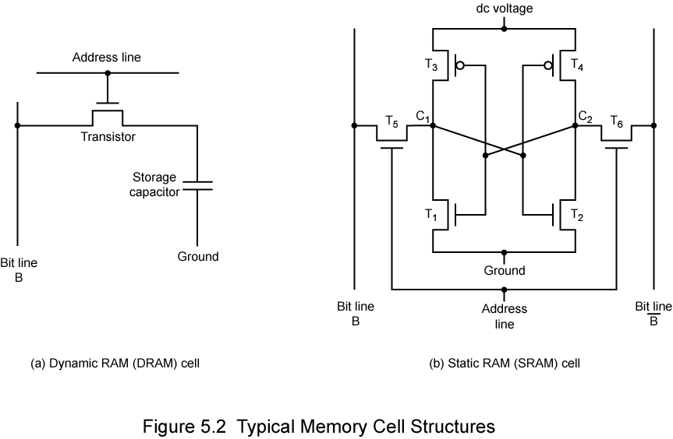
Dynamic RAM Structure

Slide 17
Dynamic RAM
Bits stored as charge in capacitors
Charges leak
Need refreshing even when powered
Simpler construction
Smaller per bit
Less expensive
Need refresh circuits
Slower
Main memory
Essentially analog
  Level of charge determines value

Slide 18
Static RAM Structure

Slide 19
Static RAM
Bits stored as on/off switches
No charges to leak
No refreshing needed when powered
More complex construction
Larger per bit
More expensive
Does not need refresh circuits
Faster
Cache
Digital
  Uses flip-flops

Slide 20
Static RAM Operation
Transistor arrangement gives stable logic state
State 1
  C₁ high, C₂ low
  T₁ T₄ off, T₂ T₃ on
State 0
  C₂ high, C₁ low
  T₂ T₃ off, T₁ T₄ on

Slide 21
SRAM v DRAM
Both volatile
  Power needed to preserve data
Dynamic cell
  Simpler to build, smaller
  More dense
  Less expensive
  Needs refresh
  Larger memory units
Static
  Faster
  Cache

Slide 22
Read Only Memory (ROM)
Permanent storage
  Nonvolatile
  Can read a ROM but cant write new data into it
TYPES OF ROM
  PROM
  EPROM
  EEPROM

Slide 23
Types of ROM
Written during manufacture
  Very expensive for small runs
Programmable (“once”)
  PROM
  Small amount of data to be written
  Less expensive
  Non volatile, written only once
  Writing performed electrically at the time of chip fabrication

Slide 24
Read “mostly”
  Erasable Programmable (EPROM)
    Erased by UV
  Electrically Erasable (EEPROM)
    Takes much longer to write than read
  Flash memory
    Erase whole memory electrically

Slide 25
EPROM
  Read and written electrically
  All storage cells should be erased electrically to initial state by exposure to UV radiation
  Can be altered multiple times and holds data virtually indefinitely
  More expensive than PROM

Slide 26
EEPROM
Can be written anytime without erasing prior contents
Write operation takes longer than read
More expensive than EPROM, less dense

Slide 27
Types of ROM
1. Programmable Read Only Memory (PROM)
Empty of data when manufactured
May be permanently programmed by the user
2. Erasable Programmable Read Only Memory (EPROM)
Can be programmed, erased and reprogrammed
The EPROM chip has a small window on top allowing it to be erased by shining ultra-violet light on it
After reprogramming the window is covered to prevent new contents being erased
Access time is around 45 – 90 nanoseconds

Slide 28
Types of ROM
3. Electrically Erasable Programmable Read Only Memory (EEPROM)
Reprogrammed electrically without using ultraviolet light
Must be removed from the computer and placed in a special machine to do this
Access times between 45 and 200 nanoseconds
4. Flash ROM
Similar to EEPROM
However, can be reprogrammed while still in the computer
Easier to upgrade programs stored in Flash ROM
Used to store programs in devices e.g. modems
Access time is around 45 – 90 nanoseconds

Slide 29
The operation of cache memory
Main
Memory
(DRAM)
1. Cache fetches data from next to current addresses in main memory
2. CPU checks to see whether the next instruction it requires is in cache
CPU
Cache
Memory
(SRAM)
4. If not, the CPU has to fetch next instruction from main memory - a much slower process
3. If it is, then the instruction is fetched from the cache – a very fast position
= Bus connections

Slide 30

Cache
Small amount of fast memory
Sits between normal main memory and CPU
May be located on CPU chip or module

Slide 31
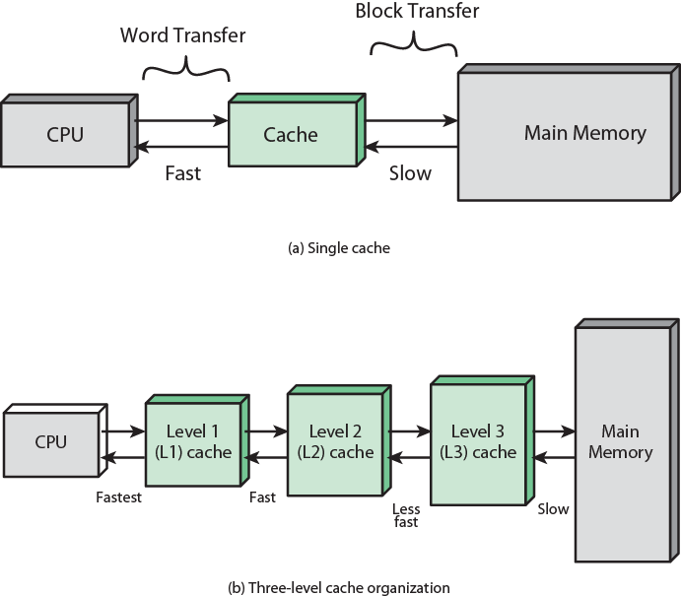
Cache and Main Memory

Slide 32
CACHE
Cache memory is a high speed memory kept in between processor and RAM to increase the data execution speed. It is kept near to the processor.

Slide 33
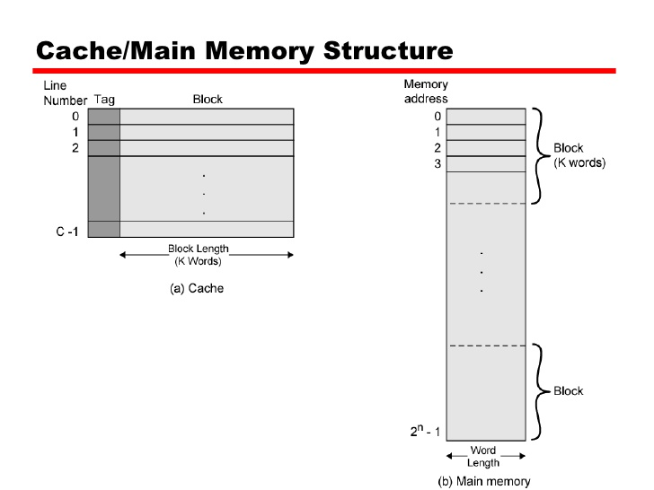
TAG - A unique identifier for a group of data.
Because different regions of memory may be
mapped into a block, the tag is used to
differentiate between them.

Slide 34
Cache operation – overview
CPU requests contents of memory location
Check cache for this data
If present, get from cache (fast)
If not present, read required block from main memory to cache
Then deliver from cache to CPU
Cache includes tags to identify which block of main memory is in each cache slot

Slide 35
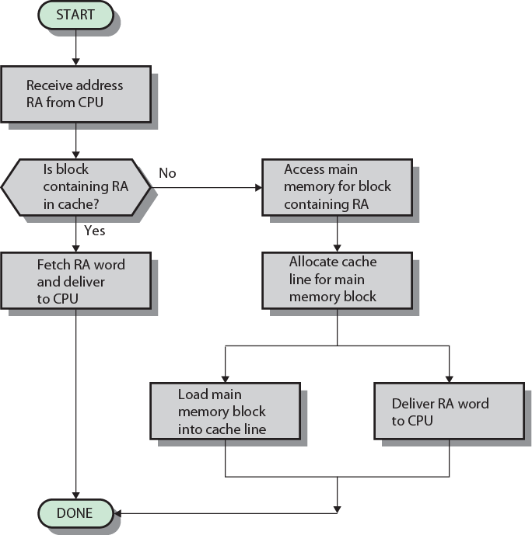
Cache Read Operation - Flowchart

Slide 36
Locality of Reference
During the course of the execution of a program, memory references tend to cluster
e.g. loops
3 types
Temporal: recently referenced inst or data
e.g loops
Spatial: whose addresses are near one another
e.g searching and sorting algo
Sequential: sequential order

Slide 37
Cache Design
Cache size
Mapping Function
Replacement Algorithm
Write Policy
Block Size
Number of Caches

Slide 38
Size does matter
Cost
  More cache is expensive
Speed
  More cache is faster (up to a point)
  Checking cache for data takes time

Slide 39
MAPPING TECHNIQUES
DIRECT MAPPING
ASSOCIATIVE MAPPING
  FULLY ASSOCIATIVE MAPPING
  SET ASSOCIATIVE MAPPING
    2-WAY SET ASSOCIATIVE MAPPING

Slide 40
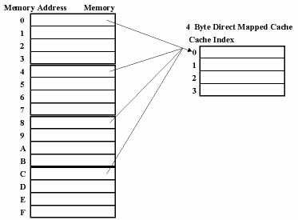
DIRECT MAPPING CONCEPT

Slide 41
DIRECT MAPPING
Cache- 128 blocks of 16 words each
  128 * 16 = 4096 approx 4 KB
Main Memory – 4K blocks of 16 words each
  4K * 16 = 64000 approx 64 KB
TOTAL ADDRESS SIZE 16 bit
5(16-(7+4)) 7(2 ⁷) 4 (2 ⁴)
Tag | Block | Word

Slide 42
Direct Mapping
Cache Line Table
Cache line Main Memory blocks held
0 0, m, 2m, 3m…2s-m
1 1,m+1, 2m+1…2s-m+1
m-1 m-1, 2m-1,3m-1…2s-1
I = J Mod M
I=cache line no
J=Block no of main memory
M=total no of slots in cache

Slide 43
Direct Mapping pros & cons
Simple
Inexpensive
Fixed location for given block
  If a program accesses 2 blocks that map to the same line repeatedly, cache misses are very high

Slide 44
Associative Mapping
A main memory block can load into any line of cache
Memory address is interpreted as tag and word
Tag uniquely identifies block of memory
Every line’s tag is examined for a match
Cache searching gets expensive

Slide 45
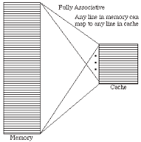
FULLY ASSOCIATIVE MAPPING

Slide 46
ASSOCIATIVE MAPPING
Cache- 128 blocks of 16 words each
128 * 16 = 2048 approx 2 KB
Main Memory – 4K blocks of 16 words each
4K * 16 = 64000 approx 64 KB
TOTAL ADDRESS SIZE 16 bit
12(16-4) 4 (2 ⁴)
Tag | Word

Slide 47
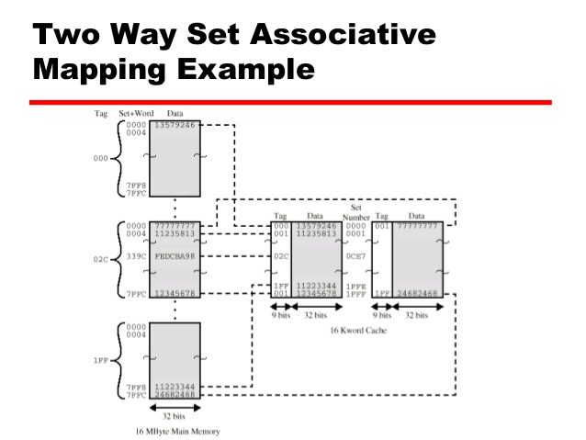
Two way set associative mapping

Slide 48
SET ASSOCIATIVE MAPPING(2-way)
Cache- 128 blocks of 16 words each
128 * 16 = 2048 approx 2 KB
Set divided into 2 ( 128 /2 ) =64
Main Memory – 4K blocks of 16 words each
4K * 16 = 64000 approx 64 KB
6(16-(4+6)) 6(2 ⁶) 4 (2 ⁴)
Tag | Set | Word

Slide 49
Set Associative Mapping
Cache is divided into a number of sets
Each set contains a number of lines
A given block maps to any line in a given set
  e.g. Block B can be in any line of set i
e.g. 2 lines per set
  2 way associative mapping
  A given block can be in one of 2 lines in only one set

Slide 50
Replacement Algorithms
Hardware implemented algorithm (speed)
Least Recently used (LRU)
  Pick the slot that hasn't been used in the longest time.
First in first out (FIFO)
  replace block that has come into cache first
Random
OPT-Optimal(Future)

Slide 51
FIFO,LRU,OPT
7,0,1,2,0,3,0,4,2,3,0,3,2,1,2,0,1,7,0,1

Slide 52
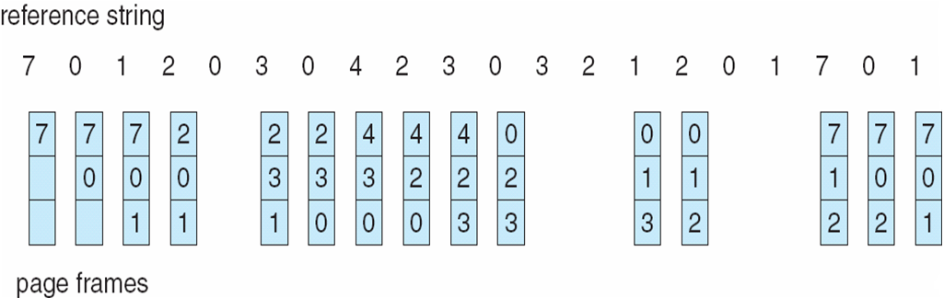
FIFO Page Replacement

Slide 53

LRU Page Replacement
A. Frank - P. Weisberg

Slide 54
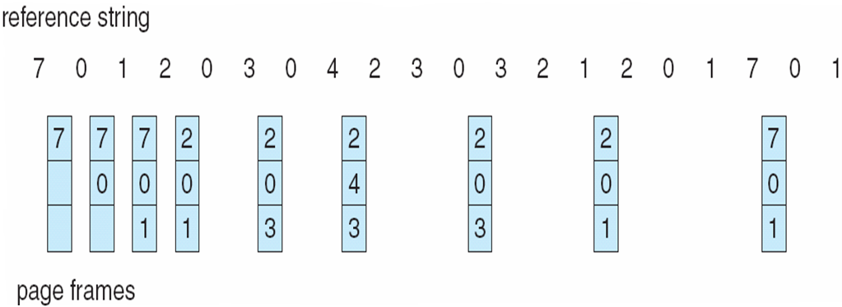
Optimal Page Replacement

Slide 55
L1 L2 L3 CACHE
L1-cache is the fastest cache and it usually comes within the processor chip itself.
The L1 cache typically ranges in size from 8KB to 64KB and uses the high-speed SRAM (static RAM) instead of the slower and cheaper DRAM (dynamic RAM) used for main memory.
The Intel Celeron processor uses two separate 16KB L1 caches, one for the instructions and one for the data.

Slide 56
L1 L2 L3 CACHE
L2 cache comes between L1 and RAM
  (Processor-L1-L2-RAM) and is bigger than the primary cache (typically 64KB to 4MB).
L3 cache is not found nowadays as its function is replaced by L2 cache. L3 caches are found on the motherboard rather than the processor. It is kept between RAM and L2 cache.

Slide 57
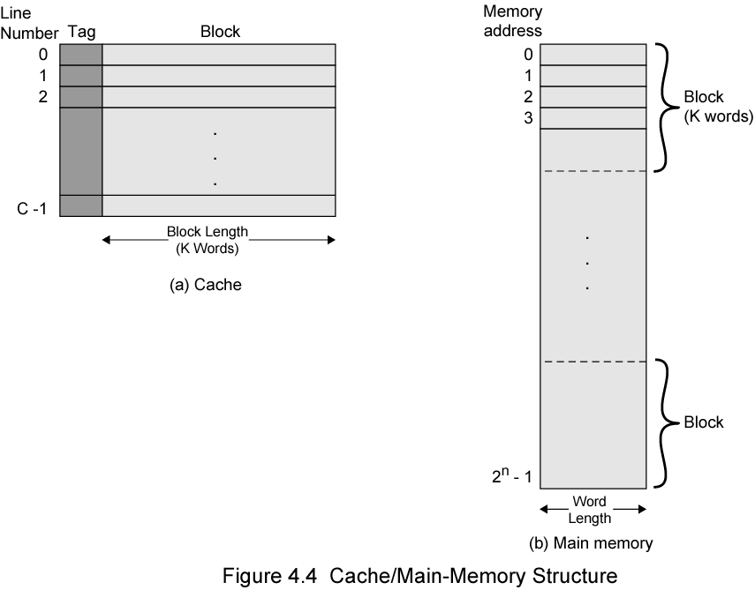
Cache/Main Memory Structure

Slide 58
Write Policy
Must not overwrite a cache block unless main memory is up to date
Multiple CPUs may have individual caches
I/O may address main memory directly

Slide 59
Write through
All writes go to main memory as well as cache
Multiple CPUs can monitor main memory traffic to keep local (to CPU) cache up to date
Lots of traffic
Slows down writes
Remember bogus write through caches!

Slide 60
Write back
Updates initially made in cache only
Update bit for cache slot is set when update occurs
If block is to be replaced, write to main memory only if update bit is set
Other caches get out of sync
I/O must access main memory through cache
N.B. 15% of memory references are writes

Slide 61
Buffered Write through
Write accesses are buffered
Read access- cache hit , can be performed simultaneously
Two consecutive write operations-cache miss ,requires processor to wait

Slide 62
Cache Coherence
Problem - multiple copies of same data in different caches
Can result in an inconsistent view of memory
Write through can also give problems unless caches monitor memory traffic
Write back policy can lead to inconsistency

Slide 63
Software Solutions
Compiler and operating system deal with problem
Overhead transferred to compile time
Complier marks data likely to be changed and OS prevents such data from being cached
Design complexity transferred from hardware to software

Slide 64
Hardware Solution
Cache coherence protocols
Dynamic recognition of potential problems
Run time
More efficient use of cache
Transparent to programmer
Snoopy protocols(to maintain cache consistency)

Slide 65
Snoopy Protocols
Distribute cache coherence responsibility among cache controllers
Cache recognizes that a line is shared
Updates announced to other caches
Suited to bus based multiprocessor
Increases bus traffic

Slide 66
Write Update
Multiple readers and writers
Updated word is distributed to all other processors
Some systems use an adaptive mixture of both solutions
Broadcast new data block to all other caches.

Slide 67
Write Invalidate
Multiple readers, one writer
When a write is required, all other caches of the line are invalidated
Writing processor then has exclusive access until line required by another processor
State of every line is marked as modified, exclusive, shared or invalid
MESI protocol

Slide 68
MESI Protocol
Processors providing cache coherence commonly implement a MESI protocol - where the letters of the acronym represent the four states that a cache line may be in:
Modified
Exclusive
Shared
Invalid

Slide 69
MESI protocol
Invalid: This cache line is not valid
Exclusive: This cache has the only copy of the data. The memory is valid.
Shared: More than one cache is holding a copy of this line. The memory copy is valid.
Modified: The line has been modified. The memory copy is invalid.

Slide 70
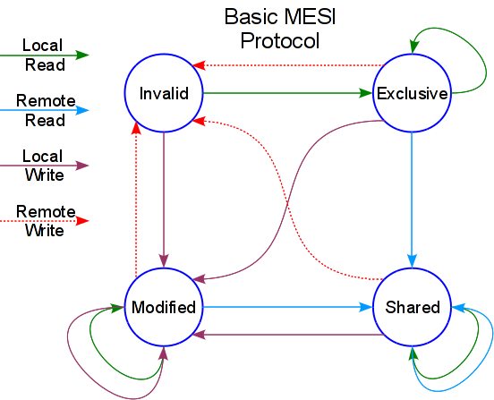


Slide 71
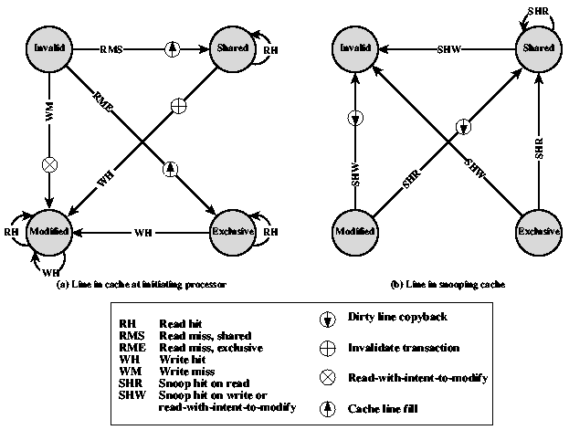
MESI State Transition Diagram

Slide 72
High Speed memories:Interleaved And Associative Memory
Interleaved memory is a design made to compensate for the relatively slow speed of dynamic random-access memory (DRAM)
Spreads memory addresses evenly across
Contiguous memory reads and writes
Resulting in higher memory throughputs due to reduced waiting.

Slide 73
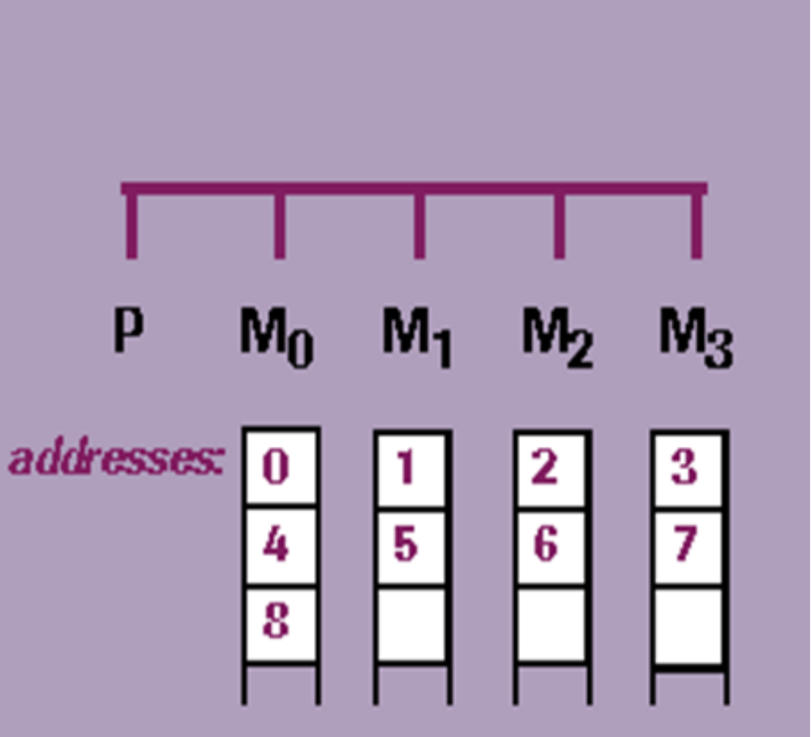

Slide 74
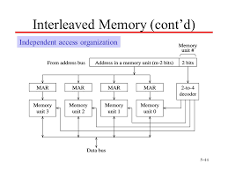

Slide 75

Content-addressed or associative memory-memory is accessed by its content (as opposed to an explicit address).
Reference clues are "associated" with actual memory contents until a desirable match (or set of matches) is found.
Humans retrieve information best when it can be linked to other related information.

Slide 76
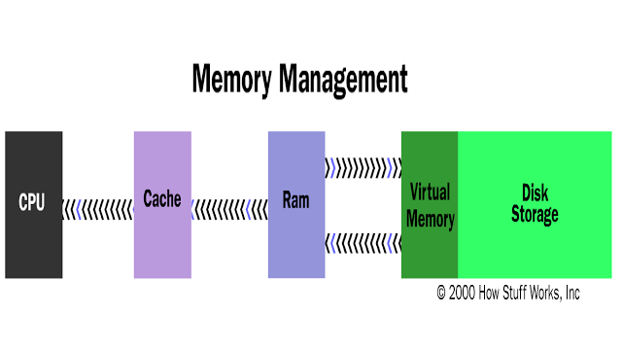
Virtual Memory

Slide 77
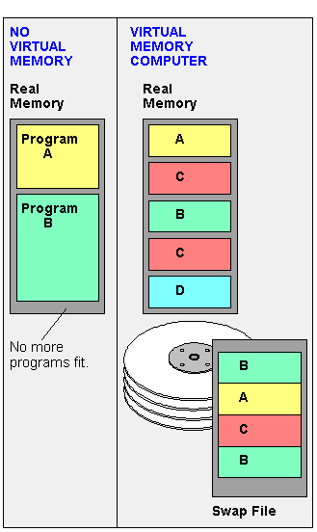

Slide 78
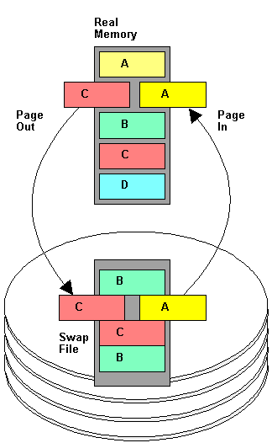
Virtual memory
Allows more programs to be opened simultaneously by using the hard disk as temporary storage of memory pages.

Slide 79
VIRTUAL MEMORY
Most computers today have something like 32 or 64MB of RAM available for the CPU to use
Not enough to run all of the programs that most users expect to run at once.
Email program,a Web browser and word processor into RAM simultaneously
Look at RAM for areas that have not been used recently and copy them onto the hard disk

Slide 80
VIRTUAL MEMORY
This frees up space in RAM to load the new application.
Copying happens automatically(feels like unlimited RAM space even though it only has 32 megabytes installed.
Hard disk space is so much cheaper than RAM chips, thus has a economic benefit. ­

Slide 81
VIRTUAL MEMORY
Read/write speed of a hard drive is much slower than RAM, and the technology of a hard drive is not geared toward accessing small pieces of data at a time.
Operating system has to constantly swap information back and forth between RAM and the hard disk. This is called thrashing, and it can make your computer feel incredibly slow.

Slide 82
PAGING
Primary memory is divided into small equal sized partitions (256, 512, 1K) called page frames.
Process are divided into same sized blocks called pages.
Only bring in the pages you are referencing and keep those you have recently referenced.
Need a page table to this management.

Slide 83
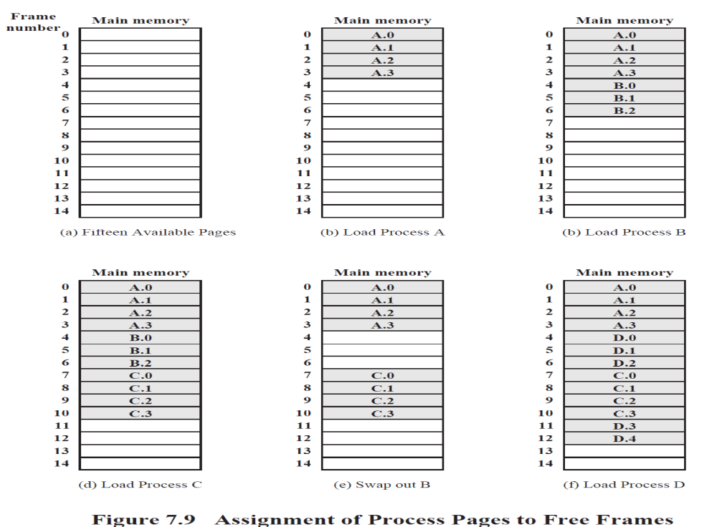

Slide 84
SEGMENTATION
Paging suffers from internal fragmentation.
Segmentation maps segments representing data structures, modules, etc. into variable partitions. Not all segments of a process again are loaded at a time, nor are they in contiguous memory blocks.
We need a segment table very much like a page table.

Slide 85
Main Memory Allocation
Memory is divided into set of contiguous locations called regions/segments/pages
Store blocks of data
Placement of blocks of information in memory is called Memory Allocation
Memory Management Systems keeps information in a table containing available and free slots

Slide 86
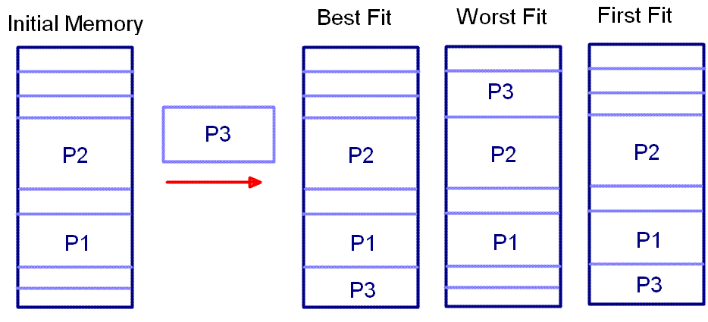
Allocation is done only as per needs
First Fit
Best Fit

Slide 87
Secondary Storage
Magnetic disks
Floppy disks
Magnetic Tape
RAID
Optical Memory
CD-ROM
DVD

Slide 88
RAID
Redundant Array of Independent Disks
Redundant Array of Inexpensive Disks
6 levels in common use
Not a hierarchy
Set of physical disks viewed as single logical drive by O/S
Data distributed across physical drives
Can use redundant capacity to store parity information

Slide 89
RAID 0
No redundancy
Data striped across all disks
Round Robin striping
Increase speed
  Multiple data requests probably not on same disk
  Disks seek in parallel
  A set of data is likely to be striped across multiple disks

Slide 90
RAID 1
Mirrored Disks
Data is striped across disks
2 copies of each stripe on separate disks
Read from either
Write to both
Recovery is simple
  Swap faulty disk & re-mirror
  No down time
Expensive

Slide 91
RAID 2
Disks are synchronized
Very small stripes
  Often single byte/word
Error correction calculated across corresponding bits on disks
Multiple parity disks store Hamming code error correction in corresponding positions
Lots of redundancy
  Expensive
  Not used

Slide 92
RAID 3
Similar to RAID 2
Only one redundant disk, no matter how large the array
Simple parity bit for each set of corresponding bits
Data on failed drive can be reconstructed from surviving data and parity info
Very high transfer rates

Slide 93
RAID 4
Each disk operates independently
Good for high I/O request rate
Large stripes
Bit by bit parity calculated across stripes on each disk
Parity stored on parity disk

Slide 94
RAID 5
Like RAID 4
Parity striped across all disks
Round robin allocation for parity stripe
Avoids RAID 4 bottleneck at parity disk
Commonly used in network servers
N.B. DOES NOT MEAN 5 DISKS!!!!!

Slide 95
RAID 6
Two parity calculations
Stored in separate blocks on different disks
User requirement of N disks needs N+2
High data availability
  Three disks need to fail for data loss
  Significant write penalty

Slide 96
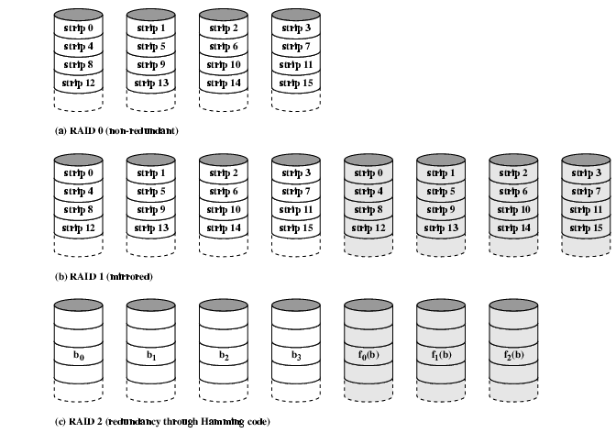
RAID 0, 1, 2

Slide 97
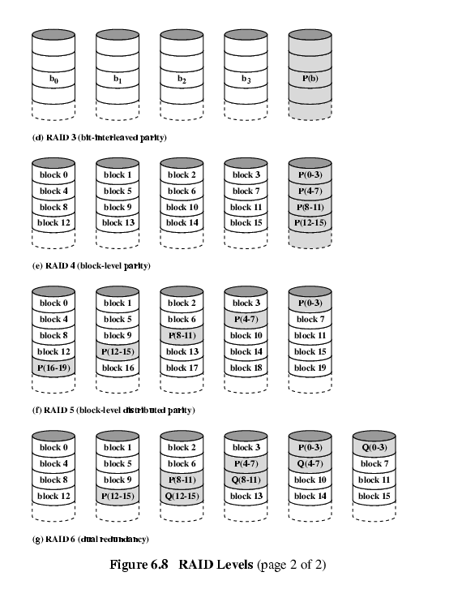
RAID 3 & 4

Slide 98
RAID 5 & 6

